Slide 1
Walk with Bare Feet on the Earth:
Test Taking
Chapter 8

Slide 2
Walking Barefoot
Many traditional people believe that the earth is our mother and that we should never do her harm.
Remembering to walk barefoot and feel her energy is soothing and healing to many.
This grounding to the earth can help you build strength and balance that will help you to deal with anxiety and improve text-taking skills.

Slide 3

Begin Your Journey with Smudging
Rids humans of negativity and brings forth positive emotions.
Commonly used before ceremonies and sweat lodges.
Connect with the Great Spirit.

Slide 4
Four Stages of Prayer
Introductions
Giving thanks
Praying for others
Petitioning for ourselves

Slide 5
We Smudge Our:
Minds to think positive thoughts
Eyes so we only look for good
Mouths so we use our words to be kind and encouraging
Hearts to provide us guidance in how we interpret the world
Spirits to connect with the universe

Slide 6

When it comes to test taking, I have trouble with . . . .

Slide 7
Strategies for Test Preparation

Slide 8
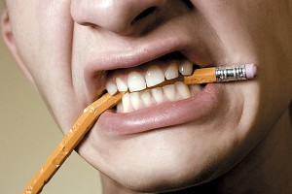
What doesn’t work in preparing for tests?
What has not worked well in the past?
Think about it.
Share your ideas with the person next to you.
Share with the class some of these ideas.

Slide 9
Preparation for exams begins the first day of class.

Slide 10
Preparation for exams begins the first day of class.
Attend class
Read the chapters. Use SQ4R.
Take notes and review them
Review periodically.

Slide 11
Manage Your Time
Schedule reading and review time.
Break it into small parts.
Use distributed practice.
Get started. Avoid procrastination.

Slide 12
Find a Time and Place to Study
Where do you study?

Slide 13


Test Review Tools

Slide 14
Flash Cards
Flash cards are an effective way to learn the details.
They are a great way to use distributed practice which is learning a little at a time.

Slide 15
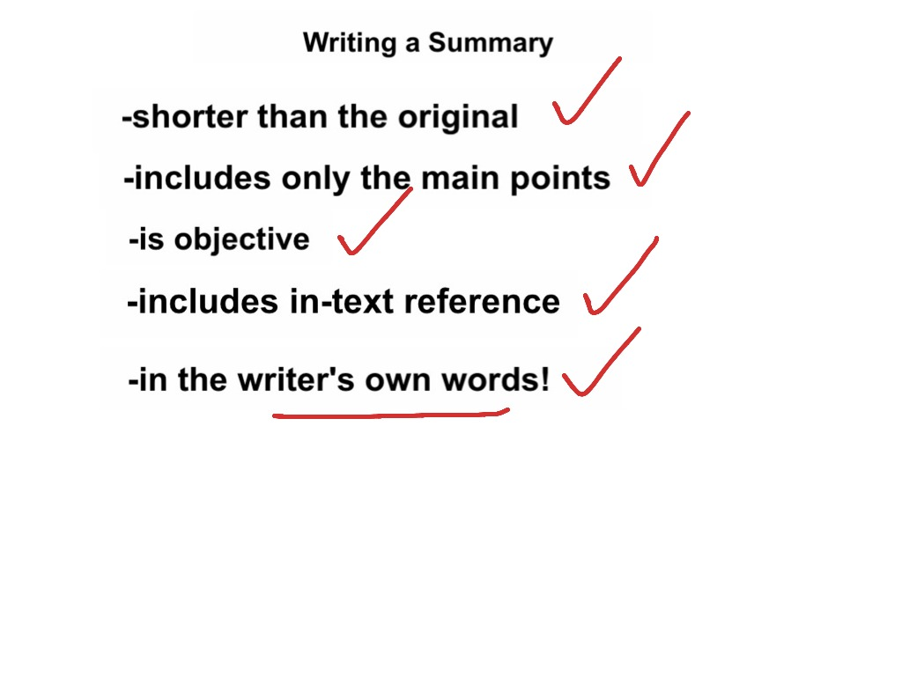
Writing a Summary

Slide 16
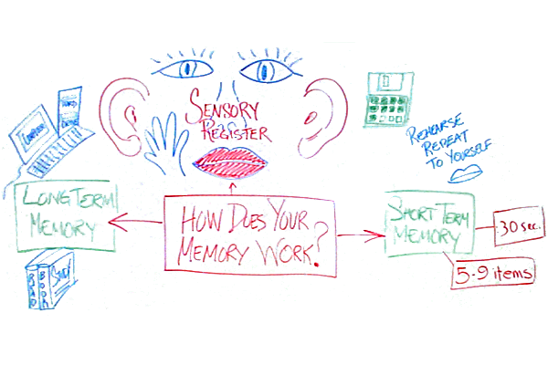
Mind Maps

Slide 17

Study Groups

Slide 18
How to Review Effectively
Immediate Review
Intermediate Review
Final Review
October

Slide 19

How to Predict the Test Questions

Slide 20
Ask About the Test
What does it cover?
What types of questions?
  True-false
  Multiple choice
  Essay

Slide 21
Predict Text Questions
Turn bold headings into questions.
Practice answering the questions.
If you are in a study group, assign each member to come up with practice questions to share with the group.

Slide 22
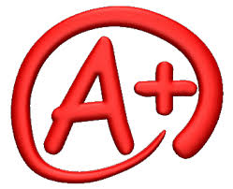
Use the first test as a guide on what to study on the next test.

Slide 23

Avoid Cramming!

Slide 24
Disadvantages of Cramming
Test anxiety
Poor use of mental ability
Performance suffers
You learn to dislike education
It is not fun
Within a week, you forget 75% of the material
It requires much effort and results in little benefit

Slide 25
Emergency Procedures
Cramming
Be selective.
Review and recite lecture notes first.
Skim and search each chapter.
Prepare summary sheets with key points.
Get enough rest.
Hope for the best.
Prepare in advance next time!

Slide 26

The Magical Seven Emergency Procedure
Start with 7 sheets of paper.
Write a key concept likely to be on the test at the top of each sheet.
Check your notes and text to write a definition, explanation or answer for each key topic.
Review and recite from the 7 sheets.

Slide 27

Dealing With Test Anxiety

Slide 28

Some anxiety is a good thing. It motivates you to study.

Slide 29
Grades just indicate how much or how well you studied for the test.
Be Successful by:
  Practicing relaxation techniques
  Being well-prepared

Slide 30

Relaxation Techniques

Slide 31

Do Some Physical Exercise
Exercise helps you to feel relaxed and energized

Slide 32

Get a Good Night’s Sleep
Lack of sleep interferes with memory
It may also make you tired and irritable

Slide 33

Take a Few Deep Breaths
Focus on your breathing to get your mind off the test.

Slide 34

Visualize Your Success
While studying, picture yourself in the classroom doing well on the test

Slide 35

Admit to Yourself that You are Anxious
You can’t fight it.
You can’t deny it either.

Slide 36

Acknowledge your anxiety. Then focus on the test.

Slide 37
Do the Easy Questions First
This will help you relax
When you are relaxed, your brain works better.
You may find the answers on the test or something that triggers your memory so that you can answer the question.

Slide 38
Yell “Stop”
Interrupt your train of thought so you can get back to the test rather than focusing on your anxiety.

Slide 39

Daydream
Daydreaming may
help you to relax and
come back to the test
with a fresh attitude.

Slide 40
Practice Perspective
It is just a grade.
It is not the end of the world.
It does not define who you are.
Think about how you can improve your performance next time.

Slide 41
Think Positively
You may have a picture of failure in your mind as a result of past experience.
Notice your mental pictures about the subject you are studying.
Make a new mental picture of success if necessary.
The future can be different.

Slide 42

Does anyone have math anxiety?

Slide 43



Start at the Beginning
Start at your skill level.
You may need to review if you have been out of school for awhile.

Slide 44

Don’t Delay Taking Math
You need math to graduate.
You need math to transfer.
You may need several math courses.
Many good paying jobs require math.

Slide 45

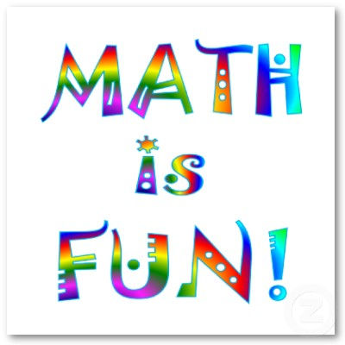
Think Positively About Your Ability to Succeed in Math

Slide 46
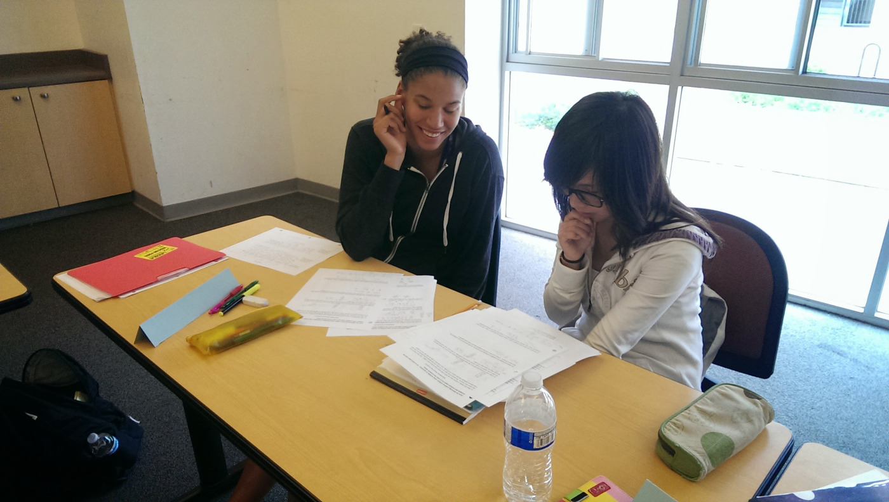
Get Help Early
Get tutoring if you get stuck.
Don’t wait!

Slide 47
Put in the Required Time
Remember that you will need about 10 hours a week to study math to be successful.
Being well-prepared reduces anxiety.

Slide 48

Don’t Miss Math Classes
It is difficult or impossible to catch up if you miss your math classes.

Slide 49

Do Your Homework Regularly
Practice until you feel confident.
You cannot cram for a math test.

Slide 50

Use a Study Group
Other students can help you to understand.
You can help others and increase your skill.
The study group can become a support group as well.

Slide 51
Math Success Formula
Hard Work
Experience
Confidence
Satisfaction
Success in Math

Slide 52
Rules for Success on Any Exam

Slide 53

Wake Up On Time or Early

Slide 54
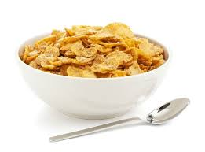
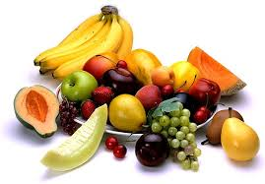
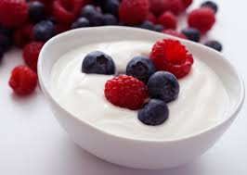
Eat a Light, Nutritious Breakfast

Slide 55

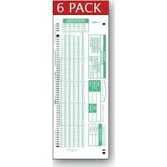
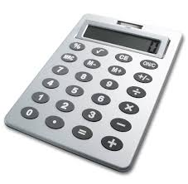
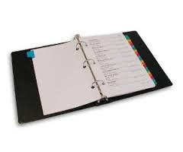
Bring the Proper Materials
Scantrons
Pencil, pen
Paper
Calculator

Slide 56

Arrive Early

Slide 57
Think Positively About the Exam

Slide 58
Read the Directions

Slide 59

Survey the Test Before You Start

Slide 60
Plan Your Time

Slide 61
Make Your Test Neat and Legible

Slide 62
Answer the Easy Questions First
This helps you to relax.
It builds your self-confidence too.

Slide 63
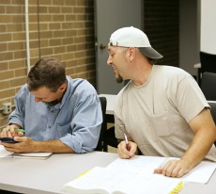
Be Careful Not to Give Any
Impression You are Cheating

Slide 64

Group Exercise:
Using a Study Group

Slide 65
Test Taking Techniques
Part II
Meet the Decoy

Slide 66
The Best Way to Prepare:
Study the key ideas
  Textbook
  Lecture notes
  Class handouts

Slide 67
Test Taking Techniques
Or how to guess if you need to
Or how to answer correctly after
you have studied

Slide 68

How To Take True-False Tests

Slide 69
How Does An Instructor Write a True False Question?
1. Find an important point
2. Write as is for true
3. Change or add a qualifier to make
it false

Slide 70
100% Qualifiers Make a Statement False. Why?
NO
NEVER
NONE
EVERY
ALWAYS
ALL
ONLY
ENTIRELY
INVARIABLY

Slide 71
These qualifiers are found in true statements. Why?
SELDOM
SOMETIMES
OFTEN
USUALLY
FREQUENTLY
MOST FEW
MANY SOME
GENERALLY

Slide 72
Tricky Questions
If any part of a true false statement is
false, the whole statement is false.
Good relaxation techniques include
deep breathing, exercise and
visualizing your failure on the exam.

Slide 73
Tricky Questions
Some tricky (usually false) statements
are composed of two sub statements
which are true and connected with a
conjunction such as:
THEREFORE
CONSEQUENTLY
AS A RESULT

Slide 74
Example
Martha does not have test anxiety,
and as a result makes good
grades on tests.
The second sub statement does
not follow logically from the first
statement.

Slide 75
Martha does not have test anxiety, and as a result makes good grades on tests.
This statement is false because she
also has to prepare for the exam. Not having test anxiety can even cause her to lack motivation to study.

Slide 76
Tricky Questions
Beware of double negatives.
No + No = Yes

Slide 77
Example of a Double Negative
Being prepared for the test is the best
way to earn good grades.
Not being unprepared for the test is
the best way to earn good grades.

Slide 78
Tricky Questions
If you have to guess, guess TRUE.
Most exams have more true questions.
Why?

Slide 79
The Multiple Choice Question

Slide 80
Begin With a True or False Question
Remember that multiple choice questions
are 4 true or false questions in a column.

Slide 81
How does the instructor write a multiple choice question?

Slide 82
Meet the Decoy

Slide 83
How to Write a Multiple-Choice Question
1. Look for an important point.
2. Make a stem.
3. Write the correct answer.
4. Think or 3 or 4 decoys.

Slide 84
EXAMPLE
Stem: In SQ4R, The 4R’S stand for:
1. Decoy
* 2. Read. Recite, review, reflect
3. Decoy
4. Decoy

Slide 85
Decoys are false statements.
Read all options. Determine which
statements are false and which are
true. Choose the BEST answer.

Slide 86
Tricky Questions
1. Watch for negatives and
100% qualifiers
2. Foolish options are generally
incorrect.

Slide 87
Example
The Cornell Format is:
A. A system for taking notes
B. A type of floor mat

Slide 88
Tricky Questions
All of the above is usually correct.
Answers in the middle range are
more likely to be correct.

Slide 89
Tricky Questions
Numbers in the middle range
are usually correct.
The Great Pyramid is ___ft. high.
A. 281
B. 381
C. 481
D. 981

Slide 90
Tricky Questions
Numbers in the middle range
are usually correct.
The Great Pyramid is ___ft. high.
A. 281 (low)
B. 381 (middle)
C. 481 (middle) (Correct answer)
D. 981 (high)

Slide 91
Who wants to be a millionaire?

Slide 92
$4000 Question: How many atoms of hydrogen are in a molecule of water?
A. 1 C. 2
B. 4 D. 6

Slide 93
$4000 Question: How many atoms of hydrogen are in a molecule of water?
A. 1 C. 2 (correct)
B. 4 D. 6

Slide 94
Tricky Questions
In look alike options, usually one is
correct and the other is a decoy.
The functional unit of the kidney
is the:
A. Pelvis
B. Nephron
C. Neuron
D. Medulla

Slide 95
Tricky Questions
In look alike options, usually one is
correct and the other is a decoy.
The functional unit of the kidney is the:
A. Pelvis
B. Nephron (look alike) (Correct)
C. Neuron (look alike)
D. Medulla

Slide 96
Who wants to be a millionaire?

Slide 97
$32,000 Question:
What president was known as the Great Communicator?
A. Reagan C. Johnson
B. Roosevelt D. Kennedy
Which answers look alike?

Slide 98
Reagan and Roosevelt look alike. Reagan is the correct answer.

Slide 99
Tricky Questions
Choose the option that is grammatically
correct.
Note:
Plurals
a/an

Slide 100
Tricky Questions
If you don’t know the answer, SKIP IT.
You may find the answer or something
that triggers your memory in the rest
of the test. Circle the ones you do not
know and come back to them later.

Slide 101
Tricky Questions
Choose the best or most complete
alternative.
When alternatives seem
equally good, select the longest one.
Why?

Slide 102
Tricky Questions
Whenever two of the options are opposites,
one is always wrong and the other is often,
but not always, right.
A decoy is a:
Right answer
Wrong answer
General qualifier
A true statement

Slide 103
Tricky Questions
Whenever two of the options are opposites,
one is always wrong and the other is often,
but not always, right.
A decoy is a:
Right answer
Wrong answer
General qualifier
A true statement

Slide 104
Ready for the “Guess” test?

Slide 105
Tips for Matching Exams
Read through both lists to discover patterns and relationships.
Count the items on each list. Are they equal?
First match the items you know for certain
Guess at the end, if you need to.

Slide 106
Tips for Sentence Completion Exams
Review facts such as definitions, names, places and dates
Use clues in the sentence to find an answer that makes sense in the sentence and fits the grammar of the sentence.

Slide 107
Essay Exams

Slide 108
The question should be answered directly in the first statement. Repeating part of the question is a good way to stay on track.

Slide 109
Tips
Manage your time so that you complete all the questions needed.
Read the directions.
Make sure you understand the question.
Jot down memory aids.
Use good writing, grammar and spelling.
Write neatly!

Slide 110
Tips
Never leave a question blank. Write down what you know. You may get partial credit.

Slide 111
Words to watch for in essay questions

Slide 112
Words to watch for in essay questions
illustrate
analyze
enumerate
outline
describe
demonstrate
compare
explain
trace

Slide 113
Words to watch for in essay questions
define
contrast
diagram
discuss
justify
relate
compare
summarize
evaluate

Slide 114
Let’s try a short essay on test preparation.

Slide 115
Let’s Warm Up for the Essay:
How to Prepare for Exams
Intellectually
Emotionally
Physically

Slide 116
Exercise:
Practice with Short Essays

Slide 117
Machine-graded tests
The answer you mark must correspond to the question
Do not make stray marks on the answer sheet

Slide 118
Open-book tests
Write down formulas.
Place post-it notes or paper clips on important pages.
Number your class notes and write a short table of contents.

Slide 119

Math Tests
Check your work.
Do the first step again.
Estimate your answer.
Is the solution logical and does it make sense?
Check for careless errors.
Get enough sleep.

Slide 120

When tests are returned:
Use them as feedback for future study
  Do you need to improve your study techniques?

Slide 121
Keys To Success:
Be Prepared

Slide 122
Success
Begins with a vision of the future
Becomes reality through hard work and preparation

Slide 123
I’m a great believer in luck, and I find the harder I work, the more I have of it.
Thomas Jefferson

Slide 124
Remember, good test preparation begins the first day of class.

Slide 125
Good Preparation is the Key to Success in Many Areas of Life
Tests
Making a business plan
Going on vacation
Having a wedding
Building a house

Slide 126

Interview from the Elder:
Ms. Elaine St. John
What are her ideas for living a long and successful life?

Slide 127
Exercises:
Test Taking Checklist
Analyze Your Test Taking Skills

